Slide 2
Network Administration/Maintenance
Network Design for existing infrastructure and proposed upgrades
Vlan design, firewall development & maintenance, ACL monitoring, NAT configuration, Spanning-Tree maintenance, (Wireless Infrastructure design, implementation, support and monitoring),
Vendor comparisons and analysis
Physical network hardware testing, installation, upgrades, and maintenance
Cable ,testing, routing, patching, tracing and repair
Network security monitoring, intrusion detection, incident interaction and auditing

Slide 3
Microsoft Windows Services
Active Directory (AD) / Lightweight Directory Access Protocol (LDAP)
Administrative file storage
Communications Server/Services
Desktop Support
Roaming Profiles
Systems Center Software/Application Suite
Operations Manager (SCOM) (Monitoring)
Configuration Manager (SCCM) (Packages/Scripts)
Data Protection Manager (DPM) (Backups)
Virtual Computing Lab
Windows Deployment Services
Desktop machine image
Windows Server Update Services
Desktop patching and updates
‘Z’-Drives
Windows Applications

Slide 4
Microsoft Windows Support/Maintenance
Active Directory design, testing, service integration, account
management, policy testing/implementation
File share design, testing, implementation, maintenance
and backup/restoration
Update review, scanning, testing and deployment
Critical update provisioning and patching
Server/Desktop image creation, modification, deployment, and
maintenance
Software review, testing, application-push to users
(manual installation where necessary)
Virtual Computing Lab cluster design, update, and maintenance
Software update, testing, addition, usage monitoring
Desktop configuration, evaluation, installation, security monitoring and maintenance
Email server/services design, installation, configuration, testing, deployment,
mailbox/list management, scanning, relay control, policy management, and
backups/restoration

Slide 5
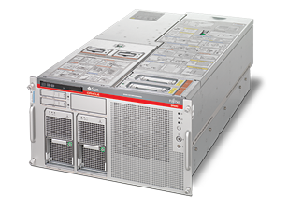
*nix
Solaris 10, Ubuntu, RHEL, CentOS
SPARC and x86_64 hardware
HPC Clusters
SMP
Cloud Computing
Oracle VM
Databases
VMWare ESX

Slide 6
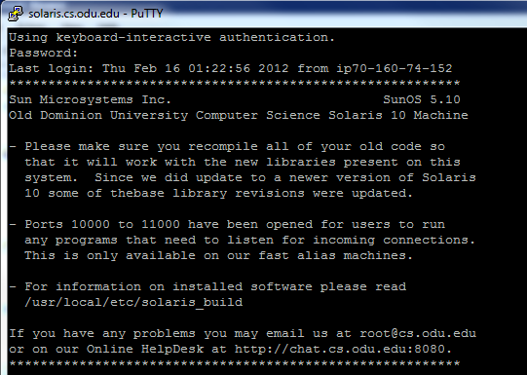
Linux & Solaris Aliases
Linux
2 Dell R910 Machines
4 Intel Xeon X7550 @ 2.00 GHz Quad Core with 128 GB of Ram
Ubuntu Server
Linux.cs.odu.edu via SSH
Solaris
3 SPARC M4000 machines with 32 Cores @ 2.5 GHz and 32 GB of Ram each
Solaris 10
Solaris.cs.odu.edu via SSH

Slide 7
Oracle VM
Dell R410 (Head Node)
4 Dell R900 (Cluster Nodes)
4 Intel Xeon E7330 @2.4GHz
16 cores
64GB RAM
2 Cluster Nodes in E&CS and 2 in Dragas
VMs can be hot-migrated manually
In event of node failure, VMs are restarted on a different node.
Currently runs 25 VMs

Slide 8
Cloud Infrastructure
Dell PowerEdge R510 (head node)
2 Intel Xeon E5620
8 Cores / 16 Threads
16GB Memory
3 Dell PowerEdge R410
2 Intel Xeon X5650
12 Cores / 24 Threads
64GB Memory
openstack – Diablo

Slide 9
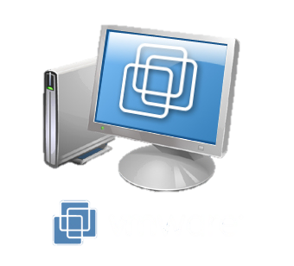
VMWare ESXi
Isolde
Dell PowerEdge R910
128GB Memory
4 Intel Xeon X7550 @ 2.00GHz
32 Cores / 64 Threads
Runs 13 VMs
Tristan
Dell PowerEdge R900
4 Intel Xeon E7330 @ 2.40GHz
64GB Memory
16 Cores / 16 Threads
Runs 11 VMs

Slide 10
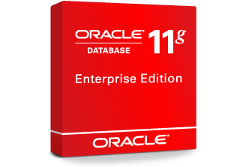
Unix Database Services
1 Dell PowerEdge R900
4 Intel Xeon 7330 @ 2.40 Ghz
64 Gbytes of RAM
Oracle 11gR2
Class DBs.
PROJ Research DB.
Virtual MySQL Server
2 Intel Xeon 7330 @ 2.40Ghz
2 Gbytes of RAM
MySQL 5.1.41
Contact root@cs.odu.edu to request personal MySQL db access.

Slide 11
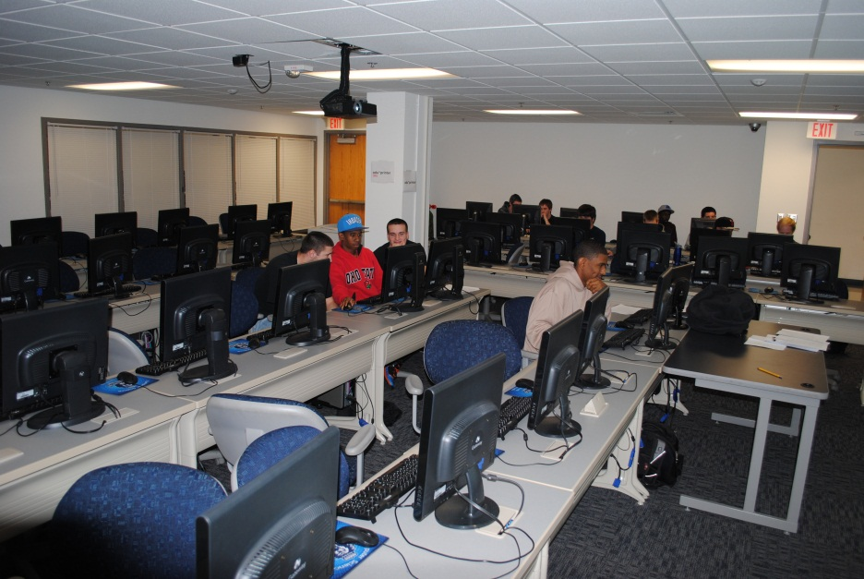
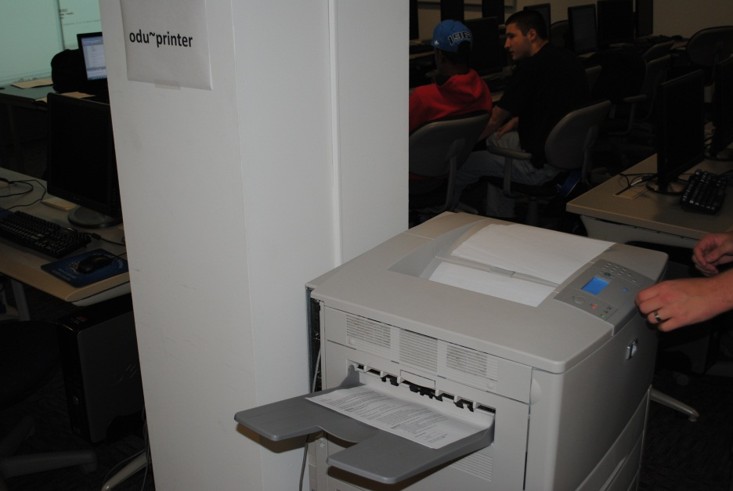
Lab Maintenance
Floorplan design/setup
Physical machine installation, imaging, update, security monitoring, app-deployment, and service
Printer maintenance, monitoring, service, and repair
Device configuration, multimedia device installation, configuration, and support
Network design, cable installation, and physical port patching
Security surveillance, end-user support, and access permissions
Power planning, testing, implementation and maintenance, and UPS design/install

Slide 12
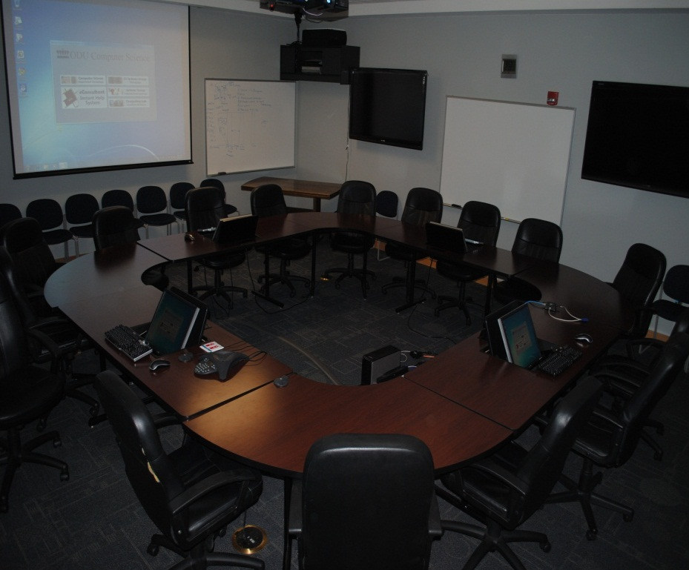
Conference Room / Access Grid Administrative Tasks
Hardware installation and maintenance
Projector installation and maintenance
Avaya phone installation and maintenance
Live PHD Dissertation Broadcasts
Live Masters Presentation Broadcasts
Video Recording
Network Stream implementation

Slide 13
HPC Clusters
Maintenance Tasks
Hardware Vendor Comparison
Purchasing
Hardware Configuration
OS Installation and Configuration
Software Installation and Upgrades
Testing
Performance Monitoring
Hardware Repairs
Assisting Users

Slide 14
SMP (Symmetric Multiprocessing)
Maintenance Tasks
Hardware Vendor Comparison
Purchasing
Hardware Configuration
OS Installation and Configuration
Software Installation and Upgrades
Testing
Performance Monitoring
Hardware Repairs
Assisting Users

Slide 15
CUDA Workstations
Maintenance Tasks
Hardware Vendor Comparison
Purchasing
Hardware Configuration
OS Installation and Configuration
Software Installation and Upgrades
Testing
Performance Monitoring
Hardware Repairs
Assisting Users

Slide 16
Proxy Card Locks
Proxy Card Administrative Tasks
51 Locks Total
16 Offline Locks
35 Online Locks
E&CS
18 Online Locks
8 Offline Locks
Dragas
14 Online Locks
8 Offline Locks
Lock definition planning
Access control
Request approval process
Updating lock DB
Manually updating locks

Slide 17
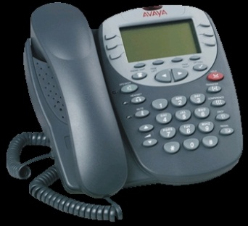
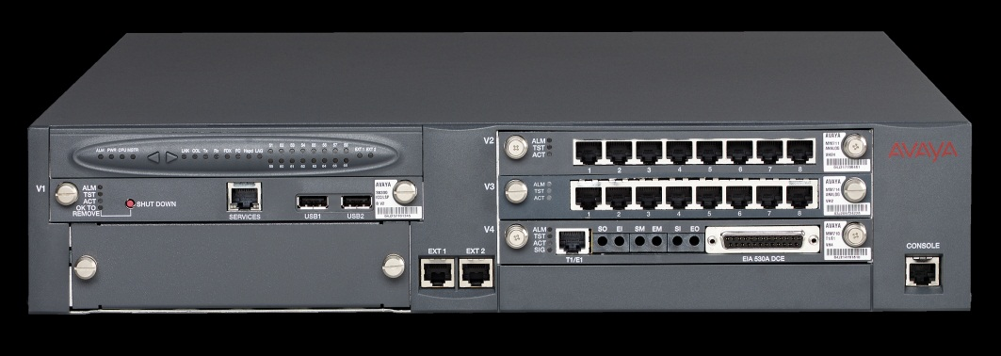
Avaya VoIP
G700 Gateway with S8300 Media Server
H.323 Call Signaling
G.711MU Audio Codec
100+ Avaya 4602, 4610, 4620, 1608, 1616 IP Stations

Slide 18
Storage
EMC Celerra NS40 in E&CS
30TB Storage
Networked via 4 1Gb Connections
EMC Celerra NS480 in Dragas
34TB Storage
Networked via 4 1Gb Connections
iSCSI targets, SMB/CIFS shares, NFS exports
Asynchronous replication between the two devices for home directories
10Gb upgrade is in the works.

Slide 19
Storage Administrative Tasks
Vendor & Feature Comparison
Storage design and planning
Storage testing
NFS
ISCSI
CIFS
Storage maintenance
Disk failure
SP failure
Storage monitoring
I/O Performance
Network Impact
Storage backups
Snapshots
Tape Backup

Slide 20
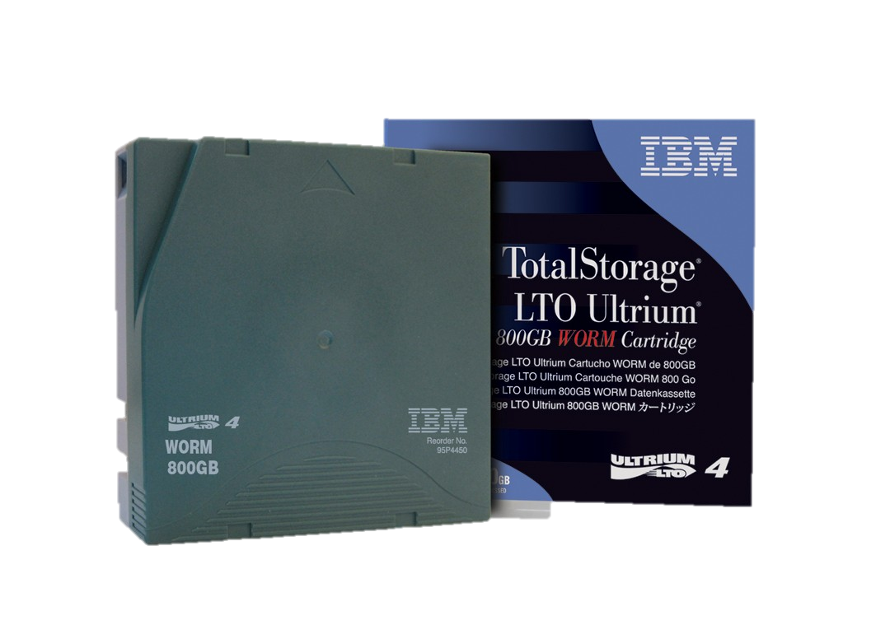
Tape Backups Administrative Tasks
Backup design, testing and implementation
Backup & Restore
Tape loading, labeling
Hardware maintenance

Slide 21
Tape Backups
Tape backups are done every night between midnight and 6AM
Most days are incremental backups
One day per month is a full backup
Incremental backups are kept for six months
Full Backups are kept for two years
The oldest data we can restore is data that was present two years ago
Contact root@cs.odu.edu to recover data from tape backups

Slide 22
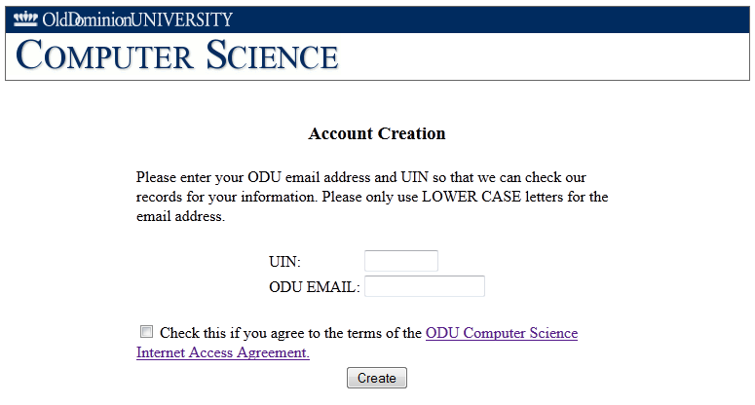
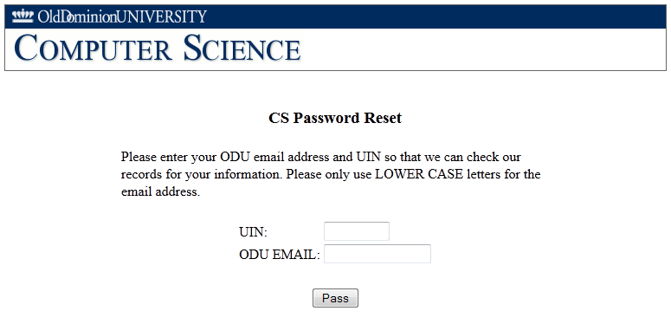
Account Creation Administrative Tasks
Design, development, documentation, testing and implementation of Account Creation Process
Policy development
Software maintenance
Password Resets Administrative Tasks
Design, development, documentation, testing and implementation of Password Reset process
Software maintenance

